Slide 1
Project Presentation
By Matthew Ernst
METC 111
4.30.2017

Slide 2
Hypothesis
From this experiment, I expect truss members AB and BC to be equal in force as they are symmetrical and equal in length. Since truss member DC acts as a hypotenuse, I would expect this member to be larger in force than the other members.

Slide 3
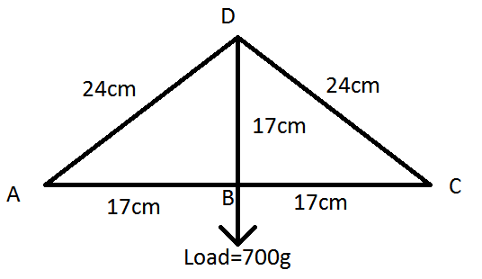
Calculated results
700g=6.86N
500g=4.90N
1000g=9.81N
Ay(0.34m)-6.86N(0.17m)=0; Ay=3.43N
3.43N(0.17m)-Fab(0.17m)=0; Fab=-3.43N=Fbc
-3.43N+6.86N-(0.17m/0.24m)Fdc=0; Fdc=4.84N
Using the same formulas but substituting different force values:
For 4.90N: Fab=Fbc=-2.45N, Fdc=3.46N
For 9.81N: Fab=Fbc=-4.905N, Fdc=6.92N

Slide 4
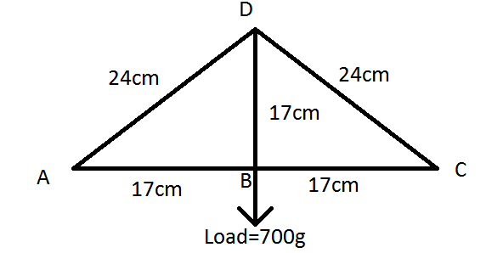
Experimental results
When we applied three load cells in members DC, AB, and BC, here were the recorded values:
  700g=-3.23N (Fab), -3.24N (Fbc), 3.36N(Fdc)
  500g=-2.23N (Fab), -2.19N (Fbc), 3.16N(Fdc)
  1000g=-4.54N (Fab), -4.58N (Fbc), 6.49N(Fdc)

Slide 5
Conclusions
The calculated values of the lab were larger, but still very similar to, the experimental values of the lab. The values of the forces were both within the same number range and were still close to the expected values. The only value that did not match was for member DC with 700g; the calculated value was 4.84N and the experimental value was 3.36N. This along with other variations of the values could have been caused by rounding errors, estimation and approximation of the recorded numbers.

